Slide 1
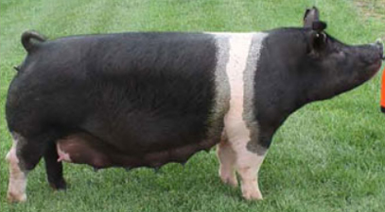
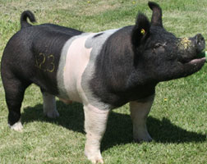
Market and Breeding Swine Selection
By Landen Gulick CEA

Slide 2
What is the point?
Better carcass quality and meat quality
Longer breeding animal longevity
Larger litter size and health
Always looking to increase herd health and quality

Slide 3
What to look for
Breeding
Market
Structure
Capacity
Growth
Muscle
Balance
Reproductive Development
Production
Muscle
Finish
Structure
Growth
Balance

Slide 4
Structure
Large bone mass
Wide and long skeleton size
Joint flexibility and movement
Topline
Looking for smooth movement
Looking for animal longevity

Slide 5
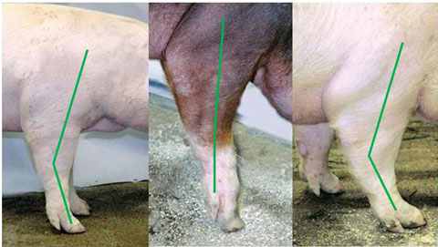
Correct
Weak Pasterns
Post Legged

Slide 6
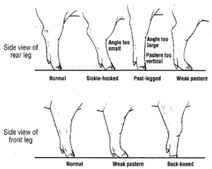

Slide 7
Body Capacity
Judge from side and behind
Depth
Volume
More important in breeding swine than market
Allows more carrying capacity for feed
More carrying capacity of piglets in bred swine

Slide 8
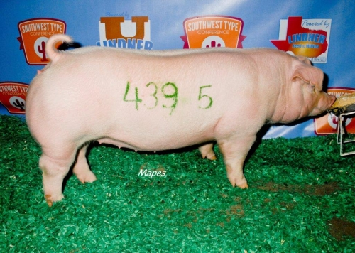

Slide 9
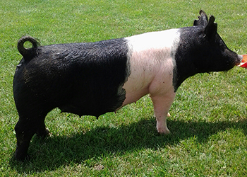

Slide 10
Muscle and Finish
Adequate muscle through the ham
Evenly wide muscling down the top
Less than 1 inch of back fat
Trim finish of fat
Defines amount of product

Slide 11
Muscling
Best observed by examining the hog from the rear.
The hog should show a wide back and loin and a deep rump.
Width must be due to muscling and not fat.
There is greater width in the ham and loin.

Slide 12
Finnsh
Refers to the amount of fat on the hog.
Is measured by the amount of backfat at three points on the top of the hog.
1. Over the shoulder (the first rib).
2. Over the loin (the last rib).
3. Over the rump.
The average backfat on a 230 lb. Hog ranges from .9 – 3.0”.
#1 hogs have less than 1/5”.
Visible signs of too much fat are: heavy, wasty jowl; Shaky middle; Square top; Looseness in the ham and crotch; Or a roll of fat over the shoulder.

Slide 13
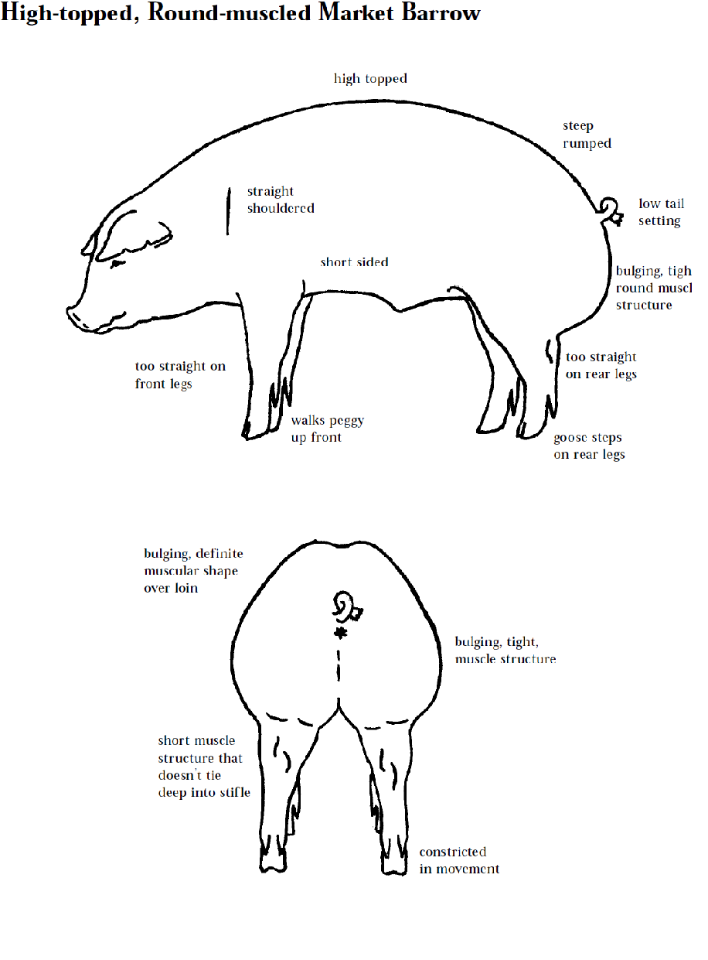

Slide 14
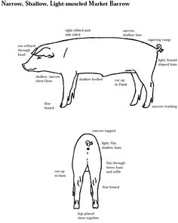

Slide 15
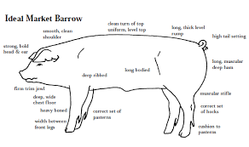

Slide 16
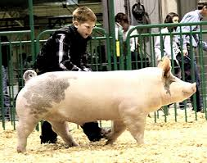
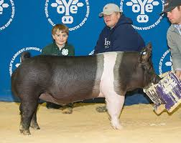

Slide 17
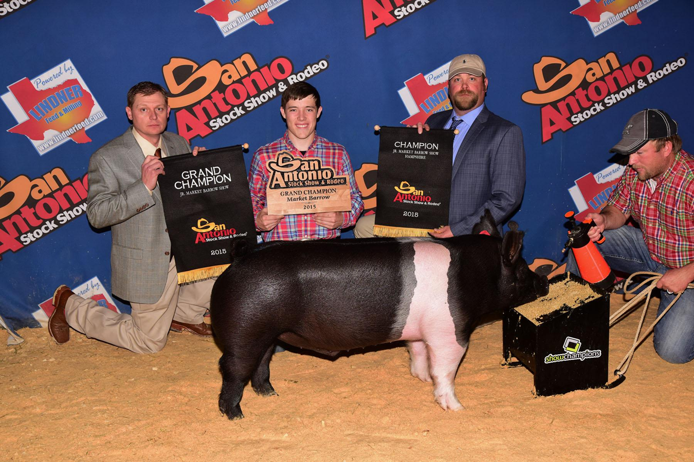

Slide 18
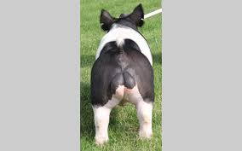
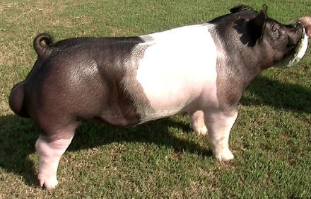

Slide 19
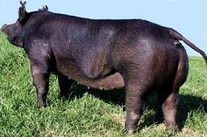
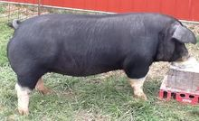

Slide 20
Balance
How animal looks and is put together
Study on the move
Gilts should be feminine and clean
Barrows should be muscular and fresh

Slide 21
More on Balance
Balance is how the body parts are proportioned.
All parts of the body should be in proportion to one another.
A well balanced hog will by tight framed.

Slide 22
Style
Style refers to how the hog appeals to the eye.
Balance influences style.
A tight framed hog that moves well, with the correct arch, has style.

Slide 23
Smoothness
Means possessing correct skeletal structure and a skin free of wrinkles.
The correct arch and a smooth shoulder are important points to look for.
Pigs with rough skins or roughness over the shoulder are undesirable.

Slide 24
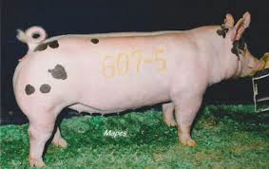
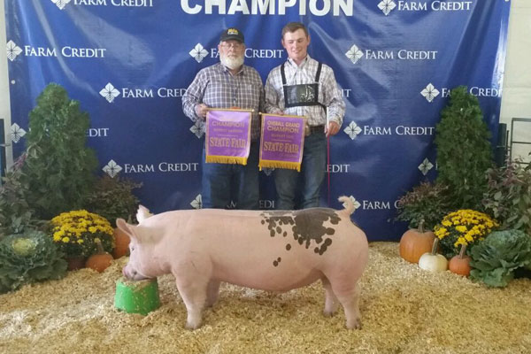

Slide 25
Breeding Hogs
Breeding hogs should have the same body traits as market hogs.
In addition, the following points are used in judging.
1. Underline: The mammary development. A minimum of 6 teats per side. None inverted or scarred.
2. Breed character: Traits of the breed. Gilt should show femininity, boars, masculinity.
3. Soundness: The feet and legs are important. They must have good feet and legs. Legs should be strong and straight and should set out well on the corners of the hog.

Slide 26
Reproduction Development
Gilts
Vulva size
Hip width for farrowing ease
Teat placement and underline development
Boars
Testicle size
Related to fertility

Slide 27
Judging Terms for Market and Breeding Hogs
Longer, bigger framed
Typier, meatier
Longer and deeper in the ham
Higher Quality
Higher quality
Firmer, heavier muscled ham
Squarer rump
Thicker through the rump
Meatier and wider at the loin
More natural thickness down the top
Cleaner, trimmer along the loin edge.

Slide 28
More General Terms
Trimmer Jowl
Larger skeletal structure
Heavier Muscled
Trimmer Finish
Smoother
sounder on front legs
Heavier bone
Nicer turn over loin
Longer, more correct muscle structure
More correct turn over the top
Trimmer underline

Slide 29
Market Hog Terms
Longer, larger framed
Heavier muscled
Longer, stretchier side
Firmer Finished barrow
Smoother Side
More uniformed rump
Longer rump
Trimmer middled
More uniform arch
Typier, meatier barrow
Longer, deeper, fuller in the ham
Cleaner top
0ore correctly finished
More muscling over the top
Thicker loin
Trimmer in jowl and underline

Slide 30
Breeding Hog Terms
Sounder underline
Stands and walks more correctly
More evenly spaced nipples
Shows more femininity
Wider Fronted
Meatier gilt
roomier-middled gilt
Shows more size & scale
More desirable set to legs
Broodier
More breed character
Straighter front or hind legs
More rugged, heavier bone
Longer, deeper sides
Growthier
Deeper, wider sprung

